Slide 1
Mushrooms: Edible or Poisonous?
By: Arjun Ganesh, Brandon Gromadzki, Julia Stewart, Rena Wolinsky

Slide 2
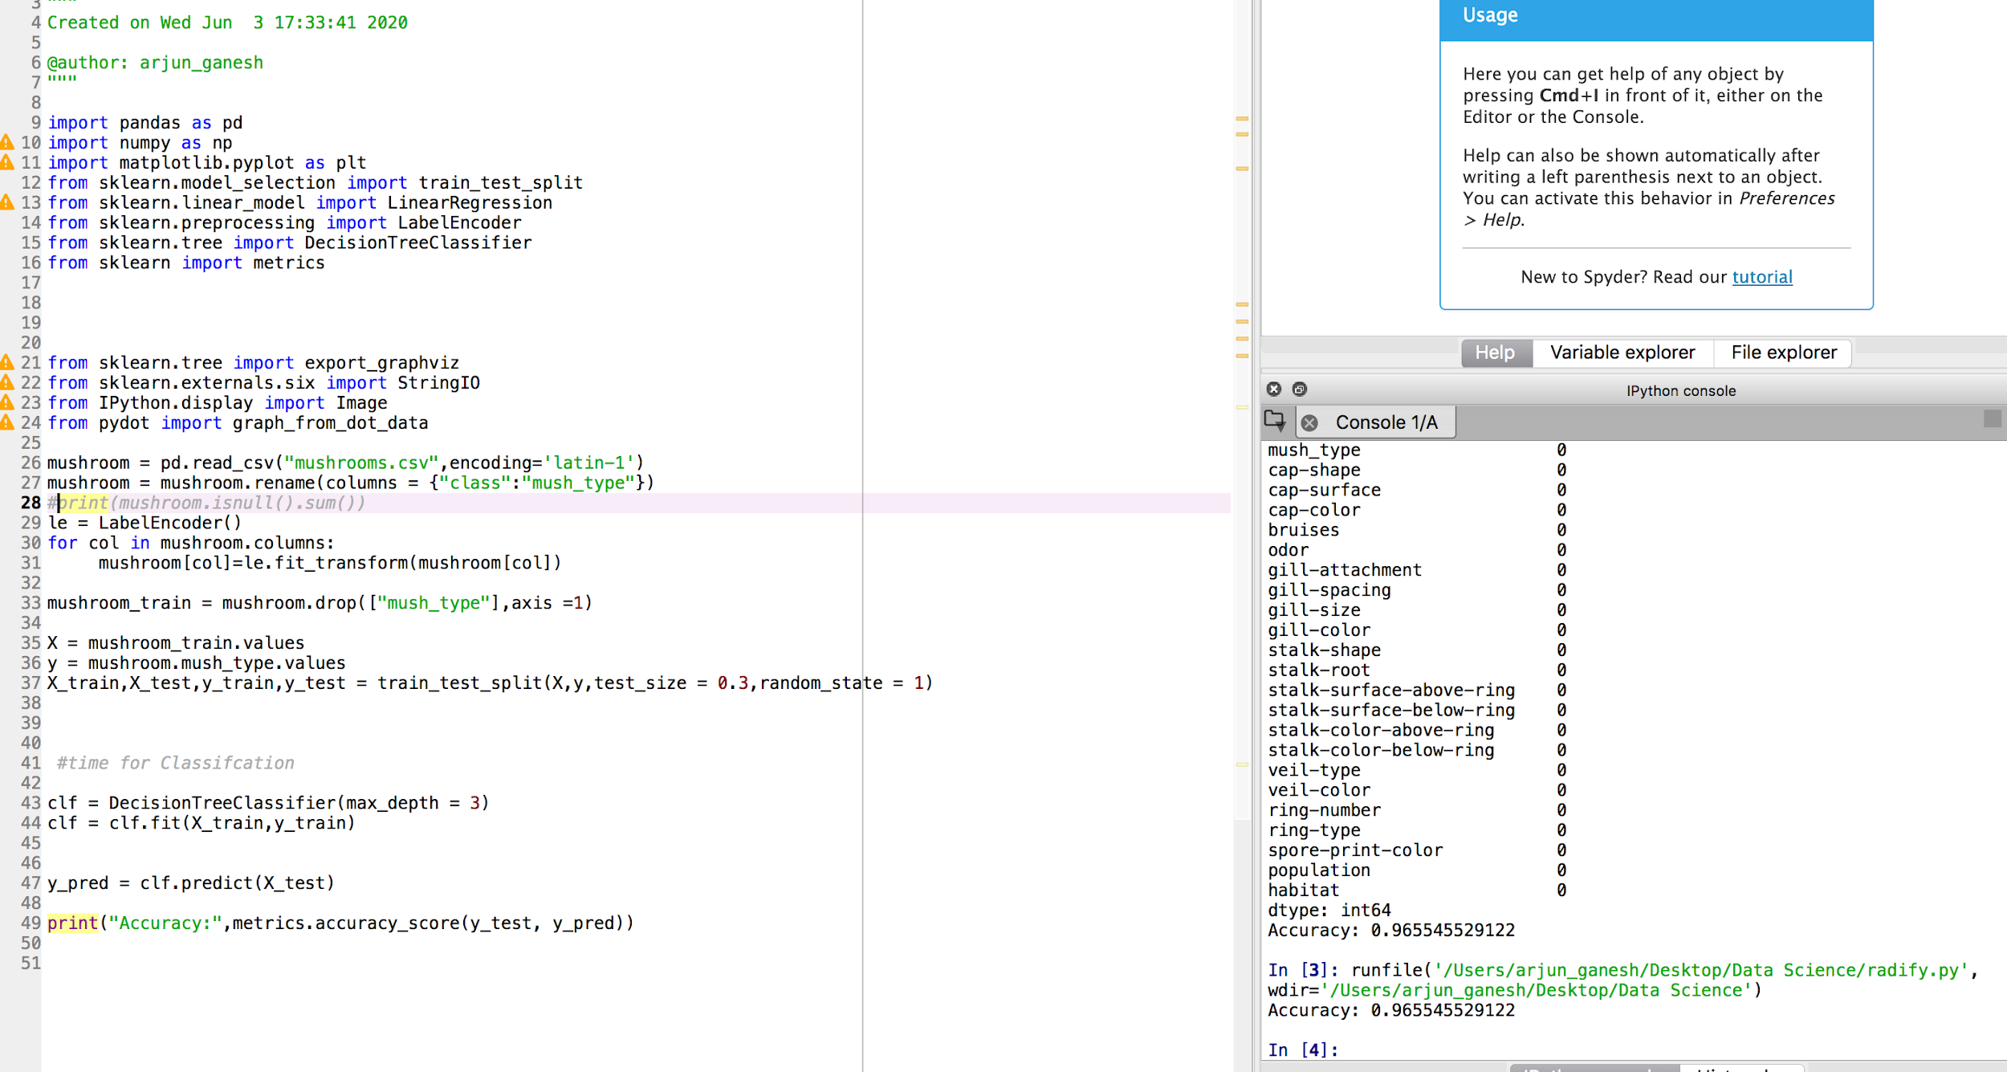
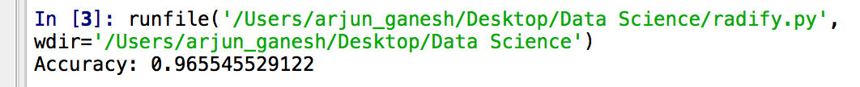
How we got there

Slide 3
Machine Learning Reflection
What ML algorithm used? Decision Tree Classifier
Cleaning code?
Difficulties executing code?
Actual Algorithm?
Improvements?

Slide 4
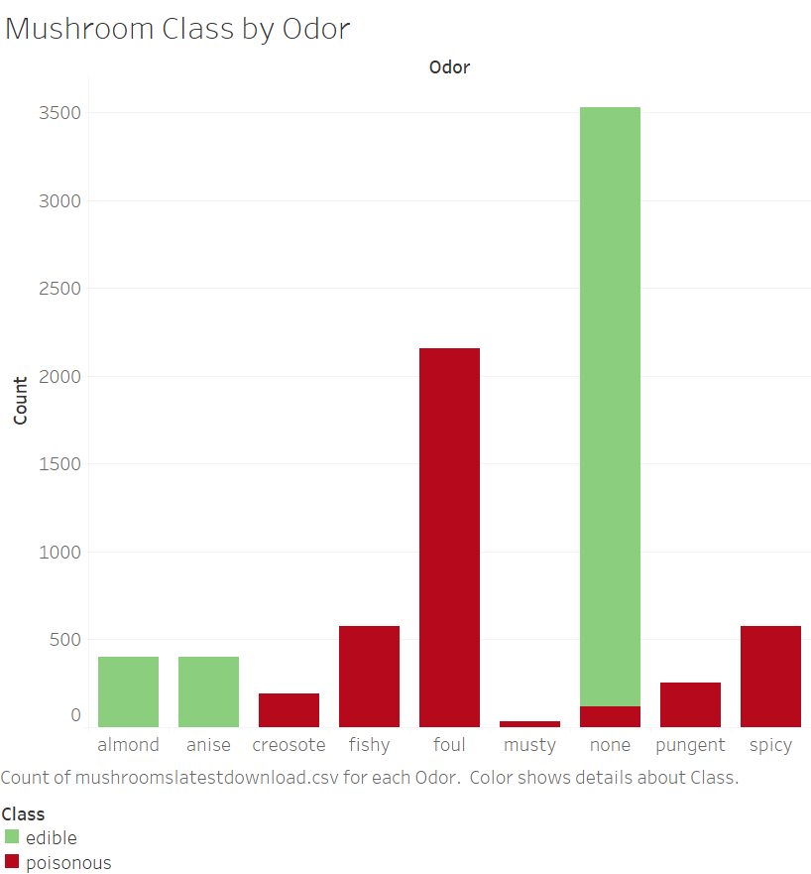
Mushroom Class by Odor

Slide 5
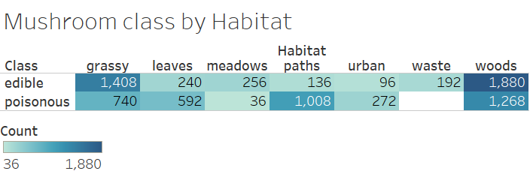
Mushroom Class by Habitat

Slide 6
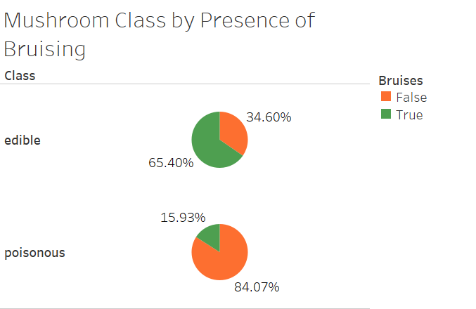
Mushroom Class by Bruising

Slide 7
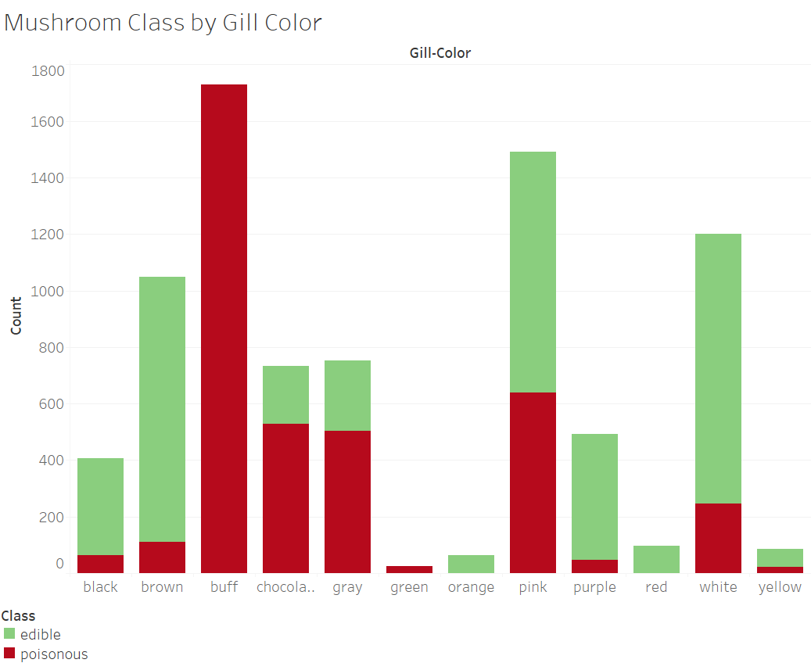
Mushroom Class by Gill Color

Slide 8
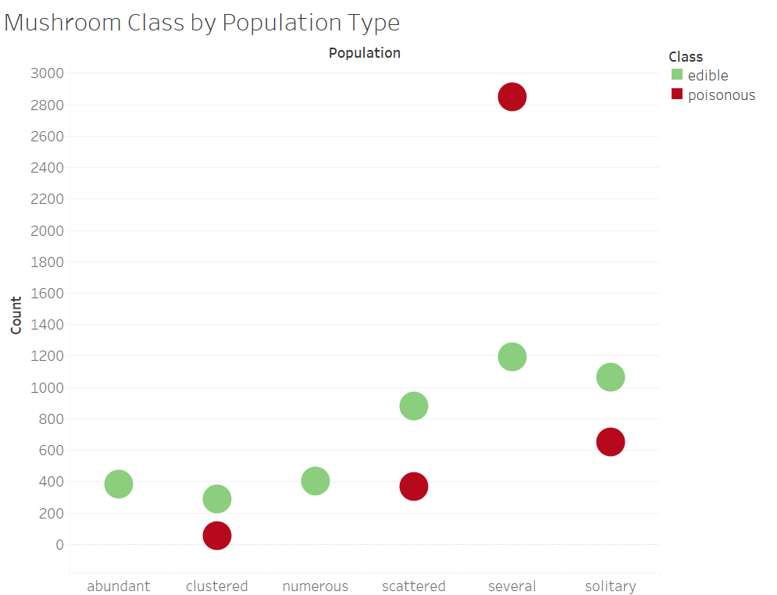
Population Type
Notes:
Looking at the growth patterns of a mushroom from our data set, we do not have a significant result from this graphic, as the results lack a disparity in many of these categories. The only category with an overwhelming difference between edible and poisonous mushrooms was mushrooms growing in multiple density variations, which isn’t the most helpful when making a choice to eat a wild mushroom.

Slide 9
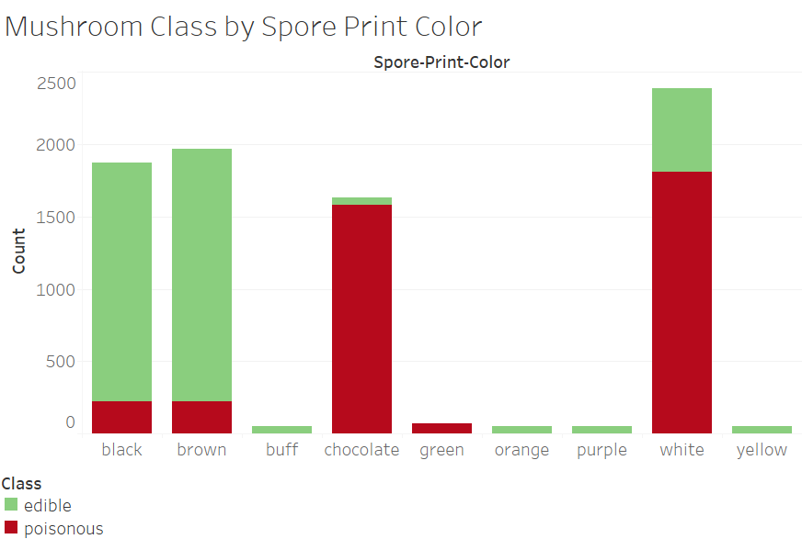
Spore Color

Slide 10
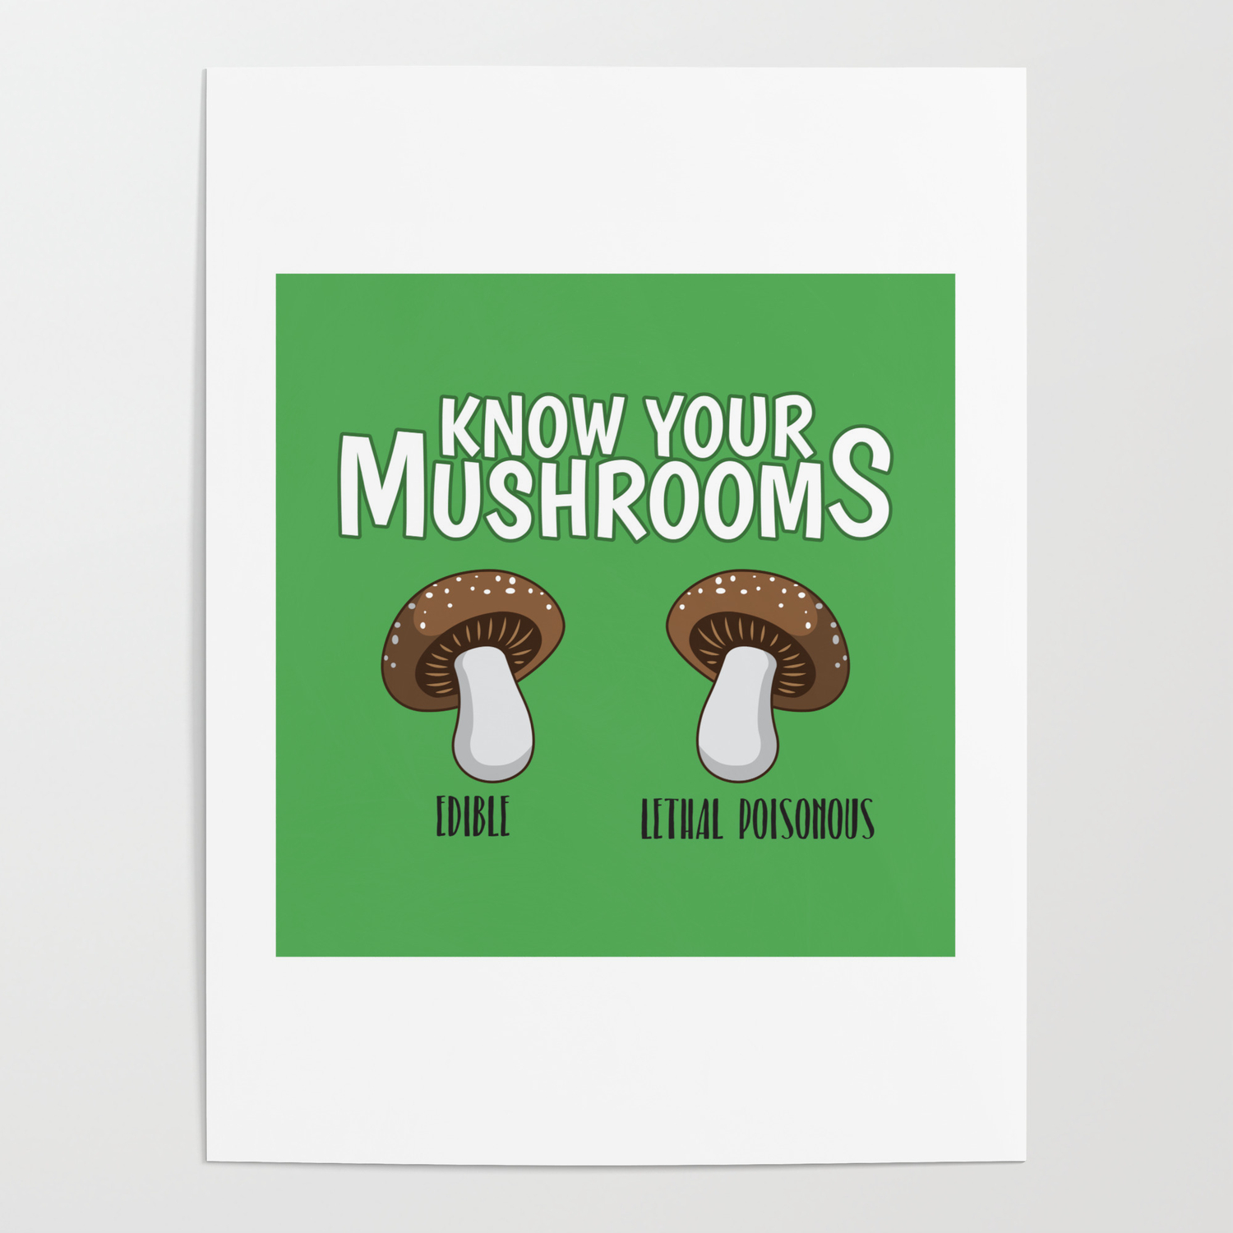
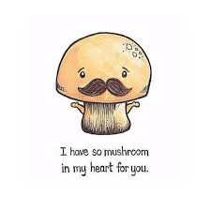
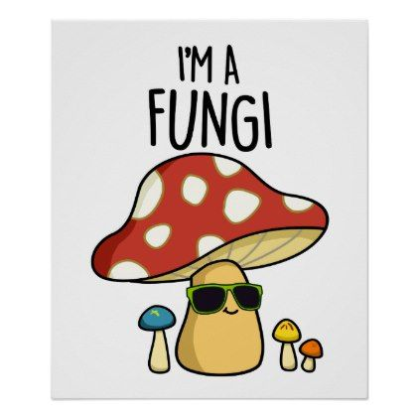
Concluding thoughts/ life applications
NEVER eat a mushroom without first running it through this decision tree since it is 100% accurate
Best Mushrooms to Eat:
No scent
Has Bruises
White or Brown Gill color
Black or Brown Spore color
Thank you for a wonderful data analytics course!
Notes:
Don’t’ eat: Foul or fishy Scented, no bruises, and ‘buff’ gills, chocolate and white spores,

